Slide 1
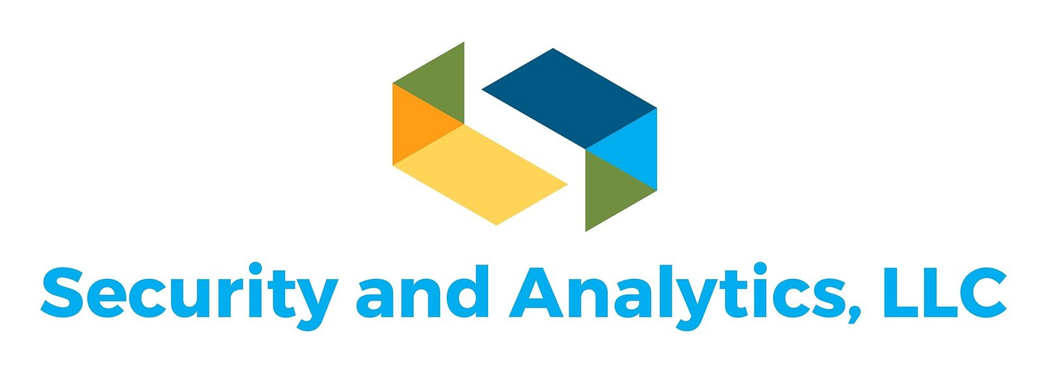
Cyber Security Threats and Defense
Gordon W Skelton, PhD, CISSP, CEH, CRISC, CISA, Security+
Security and Analytics, LLC Ridgeland, MS 39157
WWW.securityandanalytics.com

Slide 2
A GooD VIsualization
ONE SECOND FOR SET UP

Slide 3
An Oxymoron – Cyber(?)Security
No such thing as cyber security
Just doing our best to stop known threats and to reduce attack vector
Zero-day attacks are out there and coming to a computer near you
Unprepared means that your are vulnerable

Slide 4
Question?
Ever had coffee with 2% milk?

Slide 5
Question?
I’ve wondered what the other 98% is!!

Slide 6
WARNING – Cybersecurity is a BIG TopiC
I can talk it about for days and will only scratch the surface
Hold on and great ready for a ride!!!

Slide 7
What is the current state of Cyber Security?
Attackers come from both the inside and outside of all organizations
Most common means of attack – email – phishing
Insider Threats account for nearly 75% of all security breach incidents
Those breaches are either intentional or unintentional
Includes clicking on malicious emails, visiting wrong websites
Inserting USB drives
Adding their smartphone to the corporate network
Just being stupid or not paying attention, not following policies
75%

Slide 8
Cybersecurity – IT and OT
IT – information technology
OT – operations technology
As more and more industrial control systems (ICS) and System Control and Data Acquisition (SCADA) are integrated one has to be concerned about hackers
Hacker can enter through IT side and pivot to OT side
The focus of this presentation is general but can apply to OT

Slide 9
Cybersecurity – Policies and Procedures
Locate a good standard and modify to meet your needs
1st get support of executive leadership
Develop an overall cybersecurity policy for the organization
Develop specific policies and procedures for such things as Internet usage, email usage, data usage and security
Make certain everyone has received a copy, actually read, understands, and follows the policies

Slide 10
Cybersecurity Architecture Example
Example from US DoD - https://dodiac.dtic.mil/wp-content/uploads/2019/08/ia-policychart-23-July-19-DoDIN.pdf
NIST Cybersecurity Framework - https://nvlpubs.nist.gov/nistpubs/CSWP/NIST.CSWP.04162018.pdf

Slide 11
NIST Cybersecurity FRAmework

Slide 12
Types of Attackers
Professional Hackers – criminals, independent or organized
Amateur Hackers with access to advanced technologies
State Sponsored Hackers
Insiders – either intentional or by making mistakes
Disgruntled Current and Former Employees

Slide 13
How Do They Get IN?
Misconfigured firewalls and other security devices
Default usernames and passwords on devices
Malware
Employees not properly trained on cybersecurity
Phishing attacks – employees click without thinking Stop, Think Before Clicking!

Slide 14
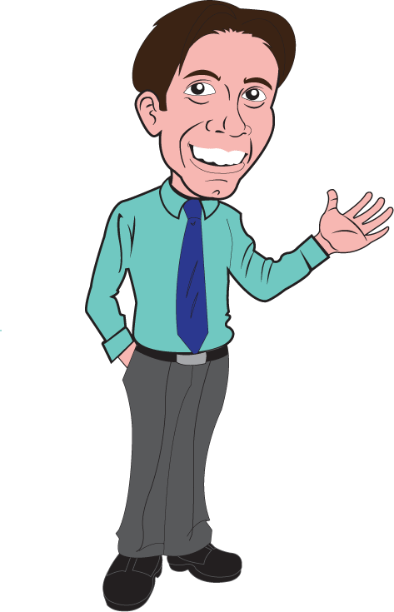
How Do they get in?
Lack of physical security
Failure to apply security patches
Old operating systems – still have people using XP, Windows 7
Social Engineering – “Hi, I’m your computer guy. What is your password?”
Following you in – piggybacking
Unlocked doors – just show up and walk in – "Glad to see you"

Slide 15
Another Observation
I got a new cellphone. The salesperson said I could keep my contacts in the phone.

Slide 16
Another Observation
Strange, I wear glasses.

Slide 17
Threat Awareness
Must be aware of the different types of attacks and how they may affect you
Locate a good website that lists current threats and attacks and check it daily
Search for your operating system (OS), equipment model, application software
Make certain that you stay aware of types of attacks that affect your industry

Slide 18
What are controls?
Tools, techniques, policies, procedures employed to prevent or stop attacks
Examples – password policy, access control, segmentation of duties, firewalls, malware protection software, Intrusion Detection System (IDS), Intrusion Prevention System (IPS), user training*, spam filters, continuous monitoring and logging – remember to view your logs or have an analysis tool do it for you

Slide 19
How to keep controls up-to-date
Automate security updates and vulnerability patches
Routine audits and vulnerability assessments
Monitor vulnerabilities for the equipment you have
Pentesting – penetration testing – control testing to make certain it is configured correctly and that is active and addressing the vulnerabilities it is designed to addressed

Slide 20
Cyber Security Failure Examples
Mississippi State Auditor’s recent report – lack of concern or no desire to report security weaknesses (STATE)
US Department of Personnel Management – China stole data on employees with security clearances (FEDERAL)
Sony – file of user names and passwords – (CORPORATE)
Credit card information stolen at gas station in Brandon, MS (PERSONAL)

Slide 21
Example of cybersecurity weakness

Slide 22
Example of cybersecurity weakness

Slide 23
Certain Data Breaches of the 21st Century
Marriott – 500m
Equifax – 143m
Adult Friend Finder – 412.2m
Anthem – 78.8m
Ebay – 145m
JP Morgan Chase – 76m

Slide 24
Certain Data Breaches of the 21st Century
Home Depot – 56m
Yahoo – 3b
Target Stores – 110m
Adobe – 38m
US Office of Personnel Management (OPM) – 22m
Sony’s Playstations Network – 77m

Slide 25
Certain Data Breaches of the 21st Century
RSA Security – 40m
Heartland Payment Systems – 134m
TJX Companies, Inc. – 94m
These came from an article entitled “The 18 biggest data breaches of the 21st Century” As with all top ten lists, there are always more to add to the list.

Slide 26
DIA Employee steals data for Reporter girlfriend and her friend
An employee of the Defense Intelligence Agency in northern Virginia was arrested Wednesday and charged with leaking top secret information to two journalists, one of whom he was romantically involved with, federal prosecutors disclosed.
The Justice Department says Henry Kyle Frese, 30, of Alexandria, Virginia, leaked government secrets involving a foreign country's weapons system in 2018 and 2019. (INSIDER)
https://www.nbcnews.com/politics/justice-department/defense-analyst-arrested-leaking-classified-information-n1064321

Slide 27
More Data Breaches
2019 Data Breaches – The Worse So Far https://www.identityforce.com/blog/2019-data-breaches
Data Breaches are like the weather, just wait a little while and the list of top breaches will change.

Slide 28
How to stop data breaches and cyber hacks
Constant vigilance
Ongoing training of all personnel on data security
Continuous update of all controls
Monitor your networks, local hosts, and network servers
Investigate the use of the cloud for data storage

Slide 29
Top Things to Do
Change the default username, password on all hardware (if possible)
Implement a password policy – longer, more complex, passphrases
Investigate multi-factor authentication
Encrypt your data both at rest and in transit
Encrypt your email

Slide 30
Top Things to do
Lock computers when away from workspace
Prevent shoulder surfing
Protect PII (Personal Identifiable Information)
Examine printer / copier security
Understand risk appetite
Understand current state of risk and protection

Slide 31
Top Things to do
Examine and harden physical security
Segmentation of Network
Least Privilege authorization
Develop and test business continuity plan
Defense in Depth – multiple layers of protection
Get commitment from the top level – CEO, Board of Directors

Slide 32
Top Things to do
Segmentation of Duties
Role-based access control
Anything else you can think of to protect your systems and data
Keep abreast of the latest attacks, vulnerabilities, and defense mechanisms
Know where you are and where you want to be – gap analysis
Evaluate costs and see what is acceptable

Slide 33
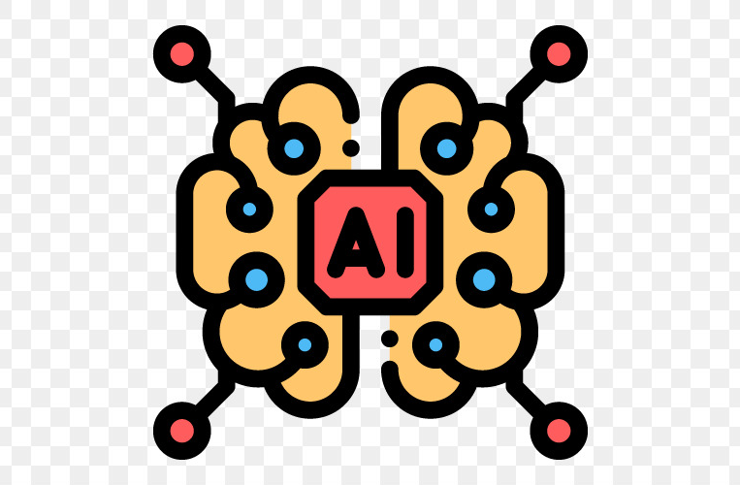
Using AI and Machine Learning For cyber Security
Don’t rely on the hype from vendors
Be aware the most important aspect of using AI / ML is the quality of the data used to train the system
Unsupervised learning is the golden standard but is lacking at present
The Zero-Day vulnerability has never been seen before
What is easy for humans is difficult for machines and visa versa

Slide 34
AL and ML have an important role to play – in the future
Remember, attackers are becoming more sophisticated and they, too, are employing AI / ML to crack passwords, evade firewalls, IDSs, other types of controls
Even with the smartest AI / ML anyone with administrative access will be able to get around that, particularly insiders!!!
Be aware of vendors in sheep’s clothing!!!!

Slide 35
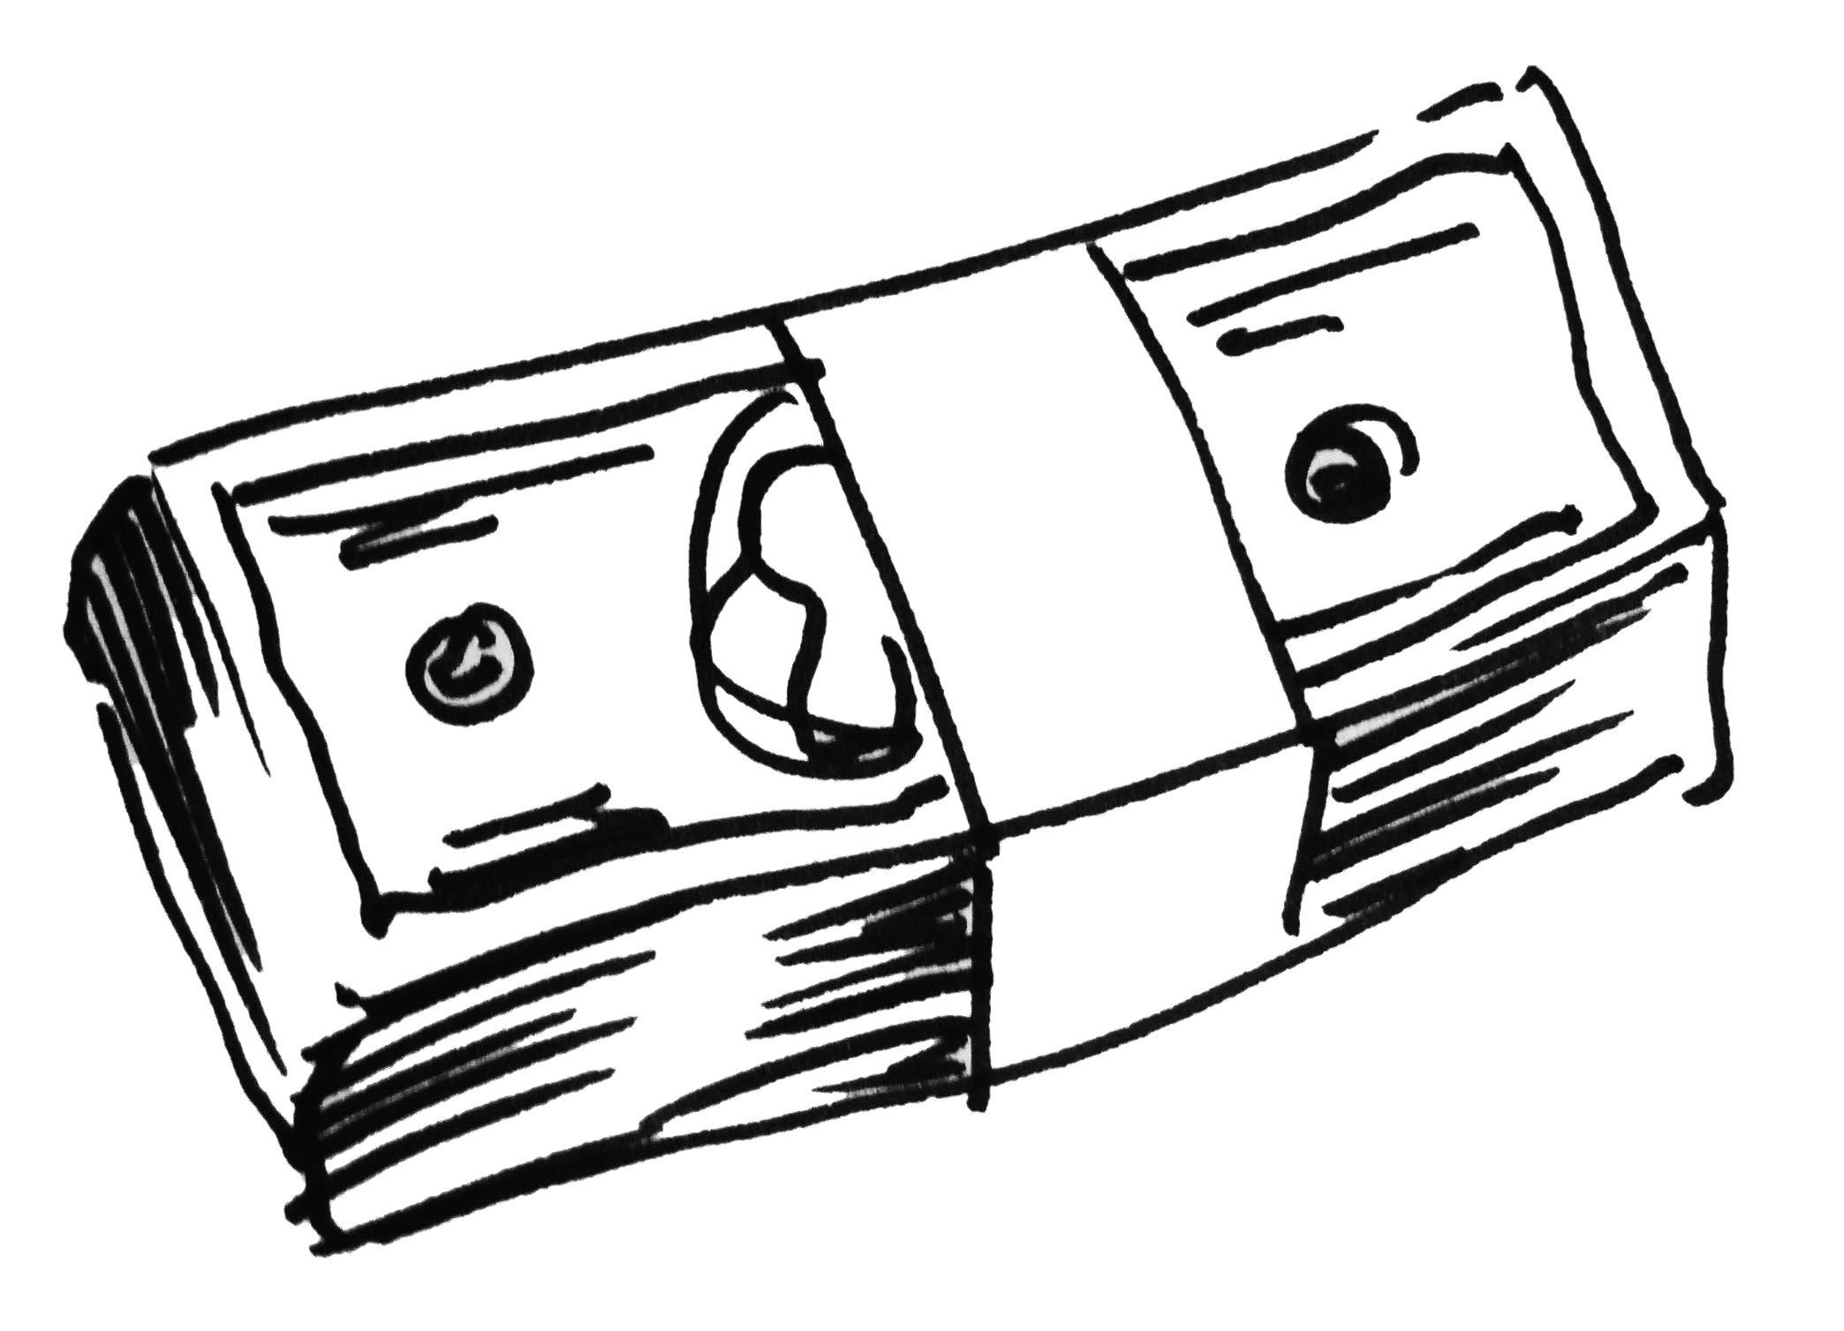
Top things to Realize
The list can go on and on, cybersecurity and threats never end
Never enough time, people, and money
Keep your resume' up-to-date - you never know when it is time to leave or you are asked to leave or the business was hacked and no longer exists

Slide 36
Wrap up of how to be vulnerable
https://www.youtube.com/watch?v=GVT5IgmA6WE

Slide 37
Questions and Comments
We can never learn enough about cybersecurity
We don’t even know how to spell cyber security / cybersecurity
If you need help please call someone professional – Who do you call ? Hackbusters! Security and Analytics, LLC 601-427-4760

